Slide 1
JavaScript: Control Statements I
Outline
Introduction
Algorithms
Pseudocode
Control Structures
if Selection Statement
if…else Selection Statement
while Repetition Statement
Formulating Algorithms: Case Study 1 (Counter-Controlled Repetition)
Formulating Algorithms with Top-Down, Stepwise Refinement: Case Study 2 (Sentinel-Controlled Repetition)
Formulating Algorithms with Top-Down, Stepwise Refinement: Case Study 3 (Nested Control Structures)
Assignment Operators
Increment and Decrement Operators
Note on Data Types
Web Resources

Slide 2
Objectives
In this lesson, you will learn:
To understand basic problem-solving techniques.
To be able to develop algorithms through the process of top-down, stepwise refinement.
To be able to use the if and if…else selection statements to choose among alternative actions.
To be able to use the while repetition statement to execute statements in a script repeatedly.
To understand counter-controlled repetition and sentinel-controlled repetition.
To be able to use the increment, decrement and assignment operators.

Slide 3
1 Introduction
Writing a script
Thorough understanding of problem
Carefully planned approach
Understand the types of building blocks that are available
Employ proven program-construction principles

Slide 4
2 Algorithms
Actions to be executed
Order in which the actions are to be executed

Slide 5
3 Pseudocode
Artificial
Informal
Helps programmers develop algorithms

Slide 6
4 Control Structures
Sequential execution
Statements execute in the order they are written
Transfer of control
Next statement to execute may not be the next one in sequence
Three control structures
Sequence structure
Selection structure
if
if…else
switch
Repetition structure
while
do…while
for
for…in

Slide 7
4 Control Structures
Flowchart
Graphical representation of algorithm or portion of algorithm
Flowlines
Indicate the order the actions of the algorithm execute
Rectangle symbol
Indicate any type of action
Oval symbol
A complete algorithm
Small circle symbol
A portion of algorithm
Diamond symbol
Indicates a decision is to be made

Slide 8
4 Control Structures
add grade to total
total = total + grade;
add 1 to counter
counter = counter +
1
;

Slide 9
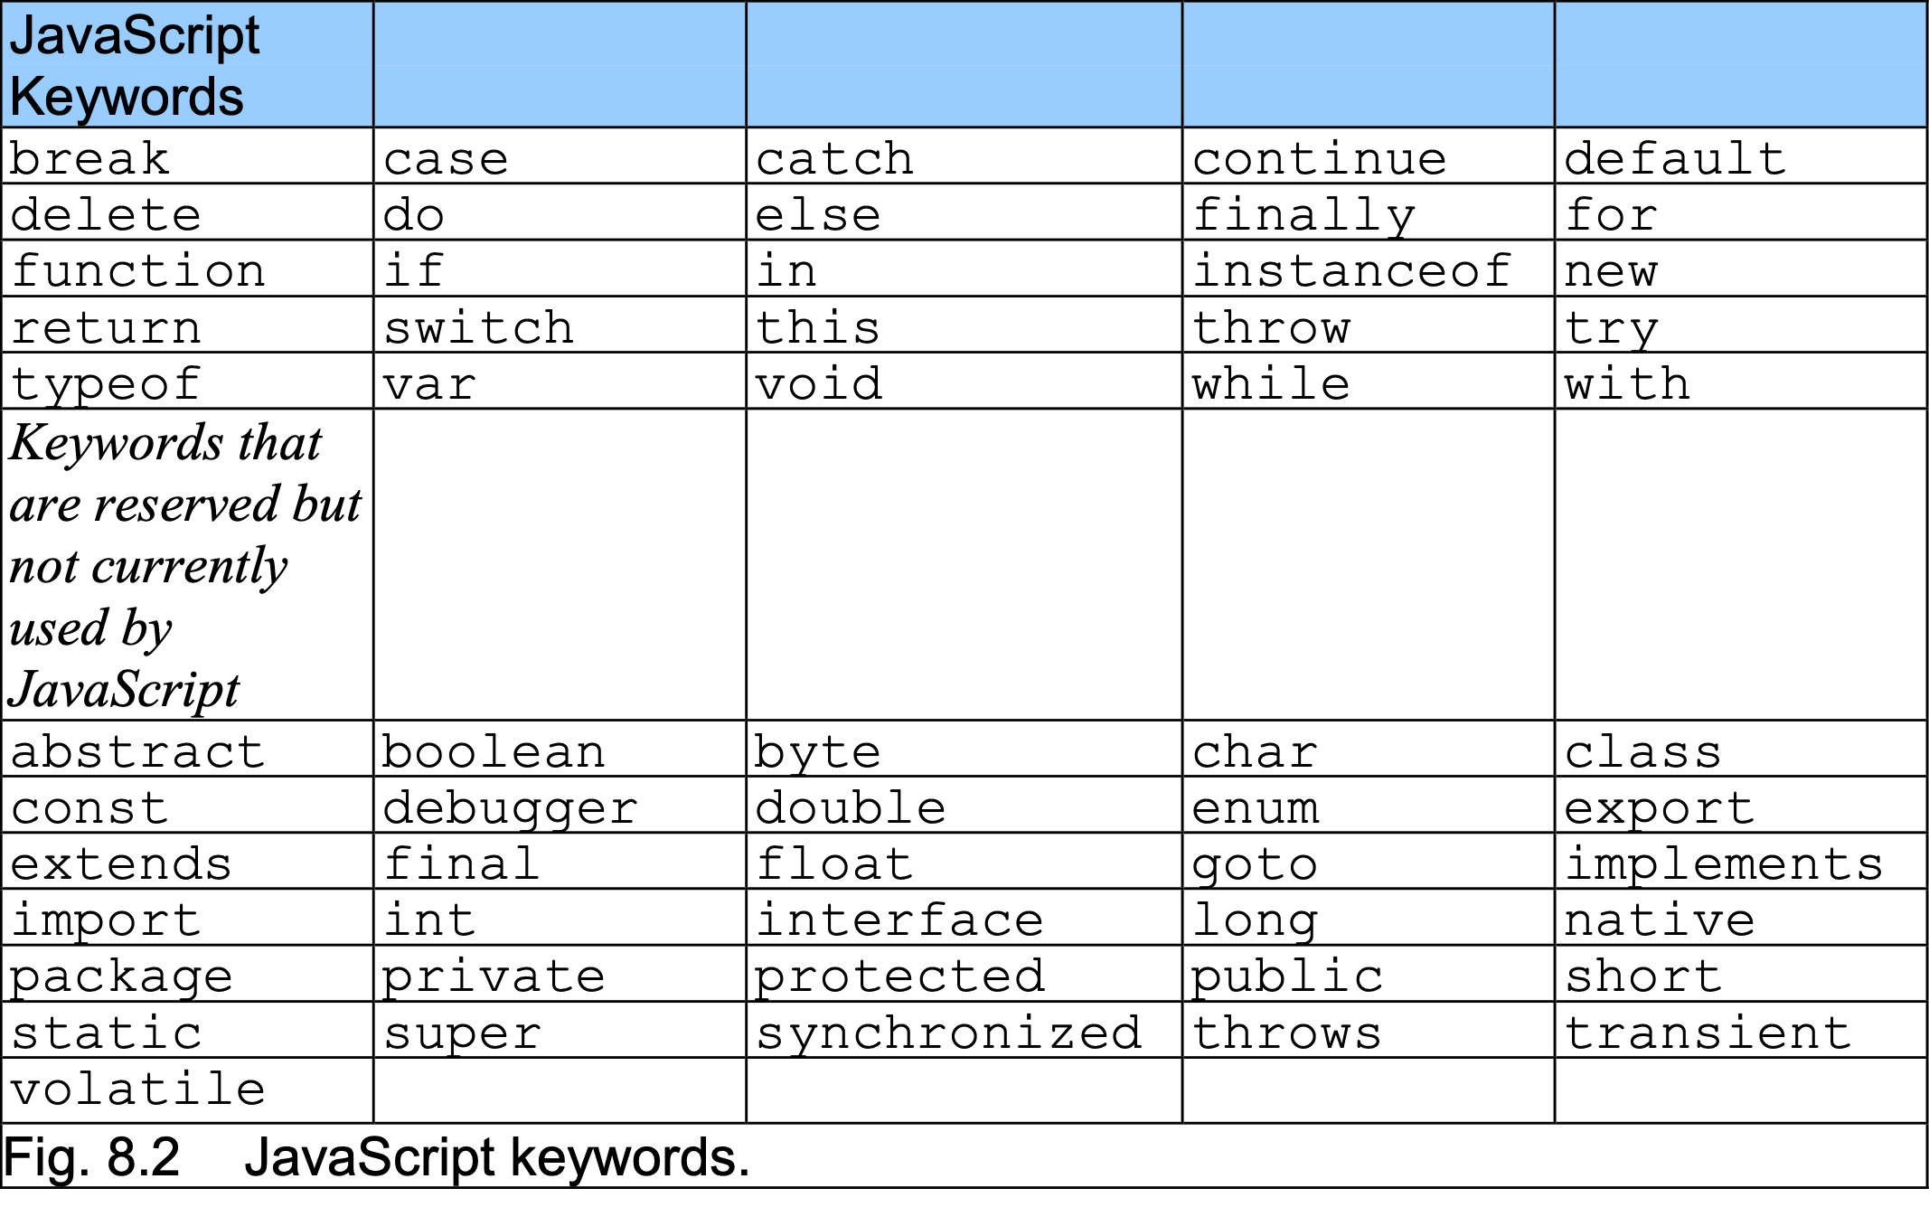
4 Control Structures

Slide 10
5 if Selection Statement
Single-entry/single-exit structure
Indicate action only when the condition evaluates to true

Slide 11
5 if Selection Statement
grade >= 60
true
print “Passed”
false

Slide 12
6 if…else Selection Statement
Indicate different actions to be perform when condition is true or false
Conditional operator (?:)
JavaScript’s only ternary operator
Three operands
Forms a conditional expression
Dangling-else problem

Slide 13
6 if…else Selection Statement
false
grade >= 60
true
print “Failed”
print “Passed”

Slide 14
7 while Repetition Statement
Repetition structure (loop)
Repeat action while some condition remains true

Slide 15
7 while Repetition Statement
true
product <=
1000
product =
2
* product
false

Slide 16
8 Formulating Algorithms: Case Study 1 (Counter-Controlled Repetition)
Counter-controlled repetition
Counter
Control the number of times a set of statements executes
Definite repetition

Slide 17
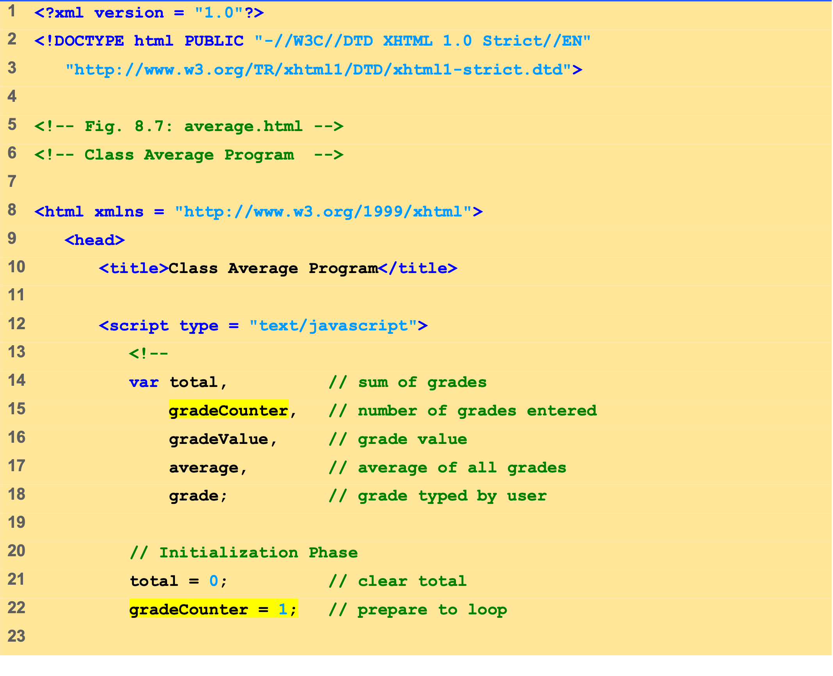
average.html (1 of 3)

Slide 18
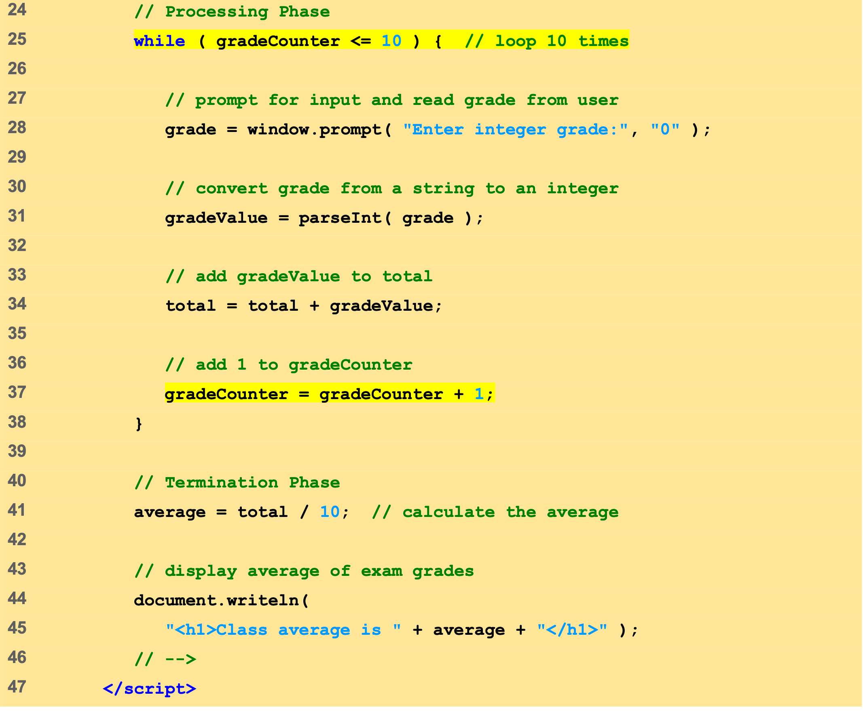
average.html (2 of 3)

Slide 19
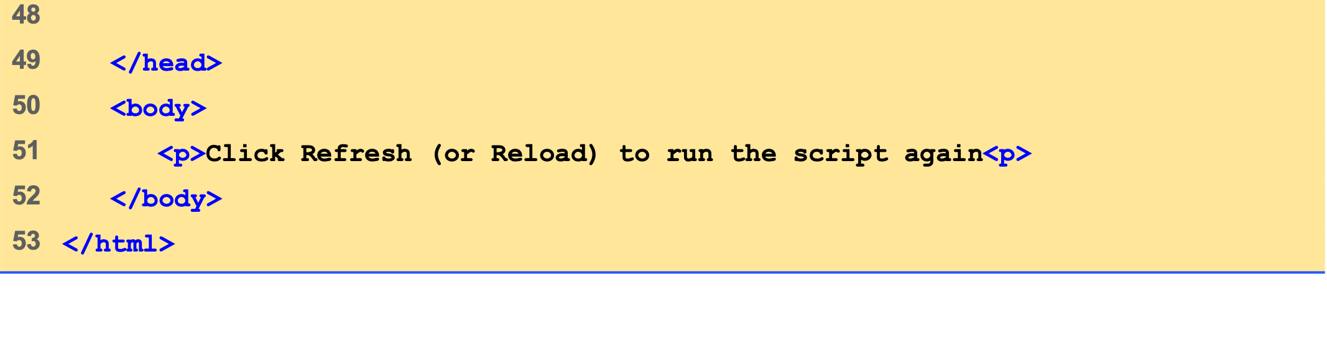
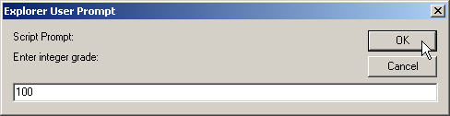
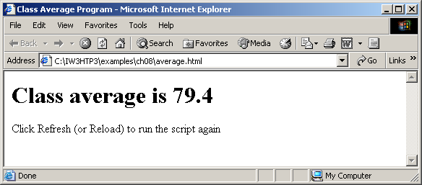
average.html (3 of 3)

Slide 20
9 Formulating Algorithms with Top-Down, Stepwise Refinement: Case Study 2 (Sentinel-Controlled Repetition)
Indefinite repetition
Sentinel value

Slide 21
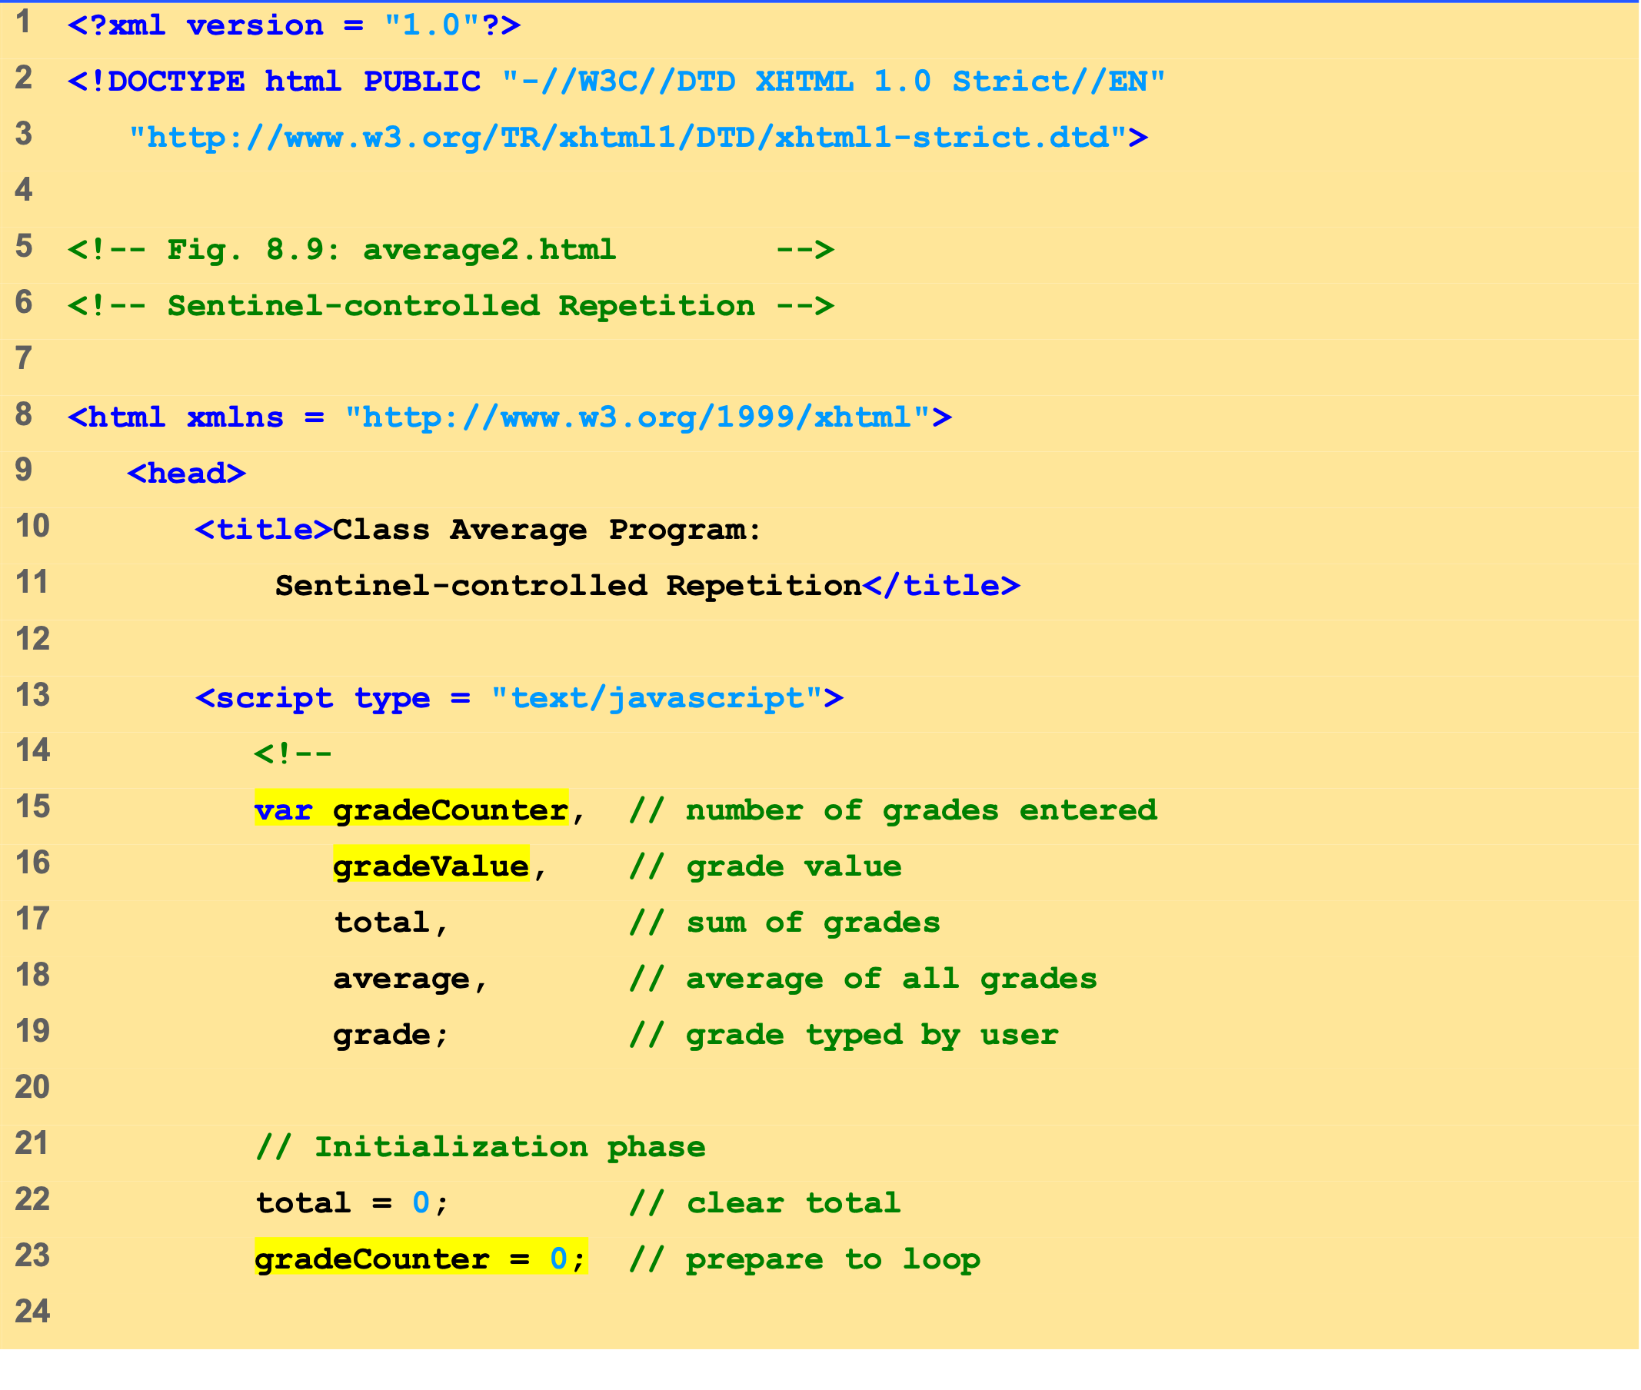
average2.html (1 of 3)

Slide 22
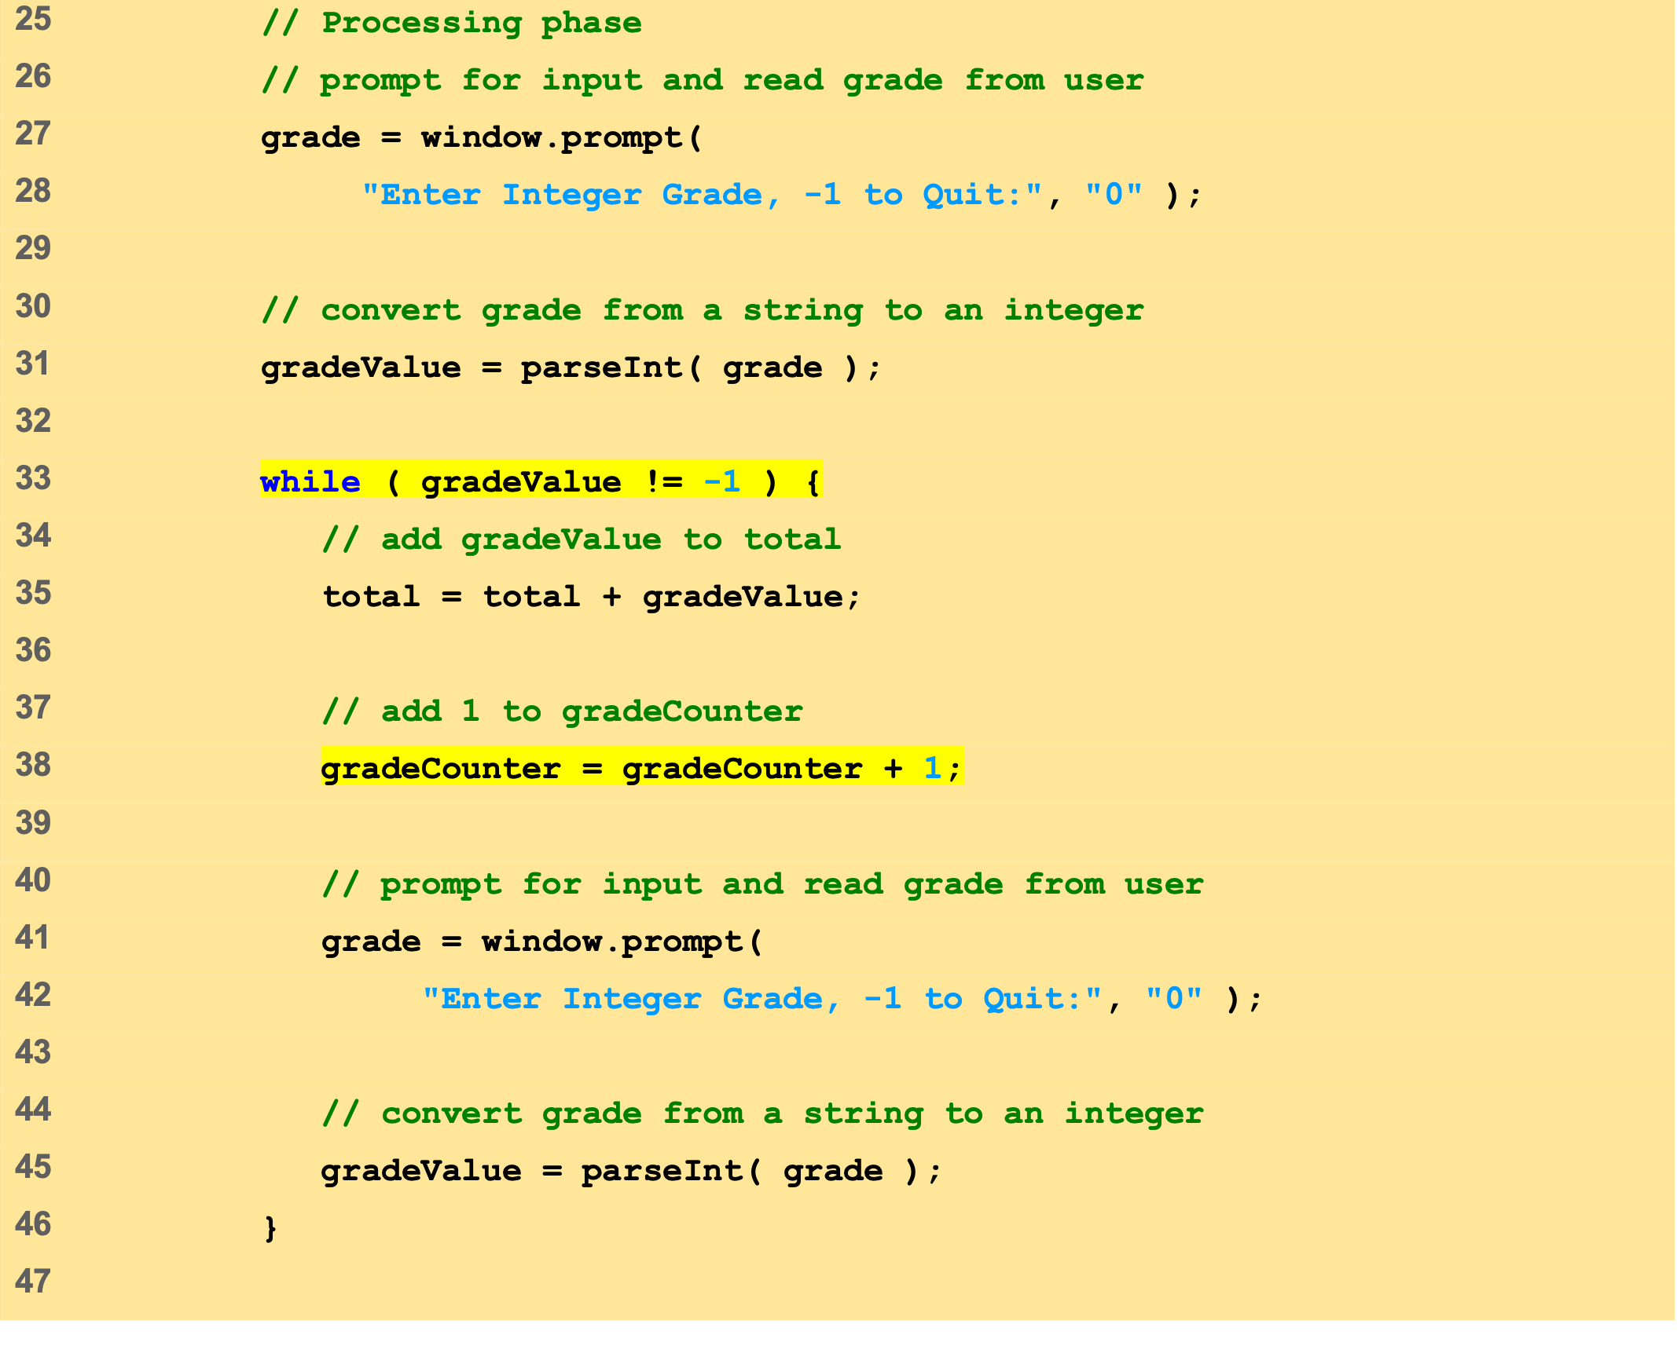
average2.html (2 of 3)

Slide 23
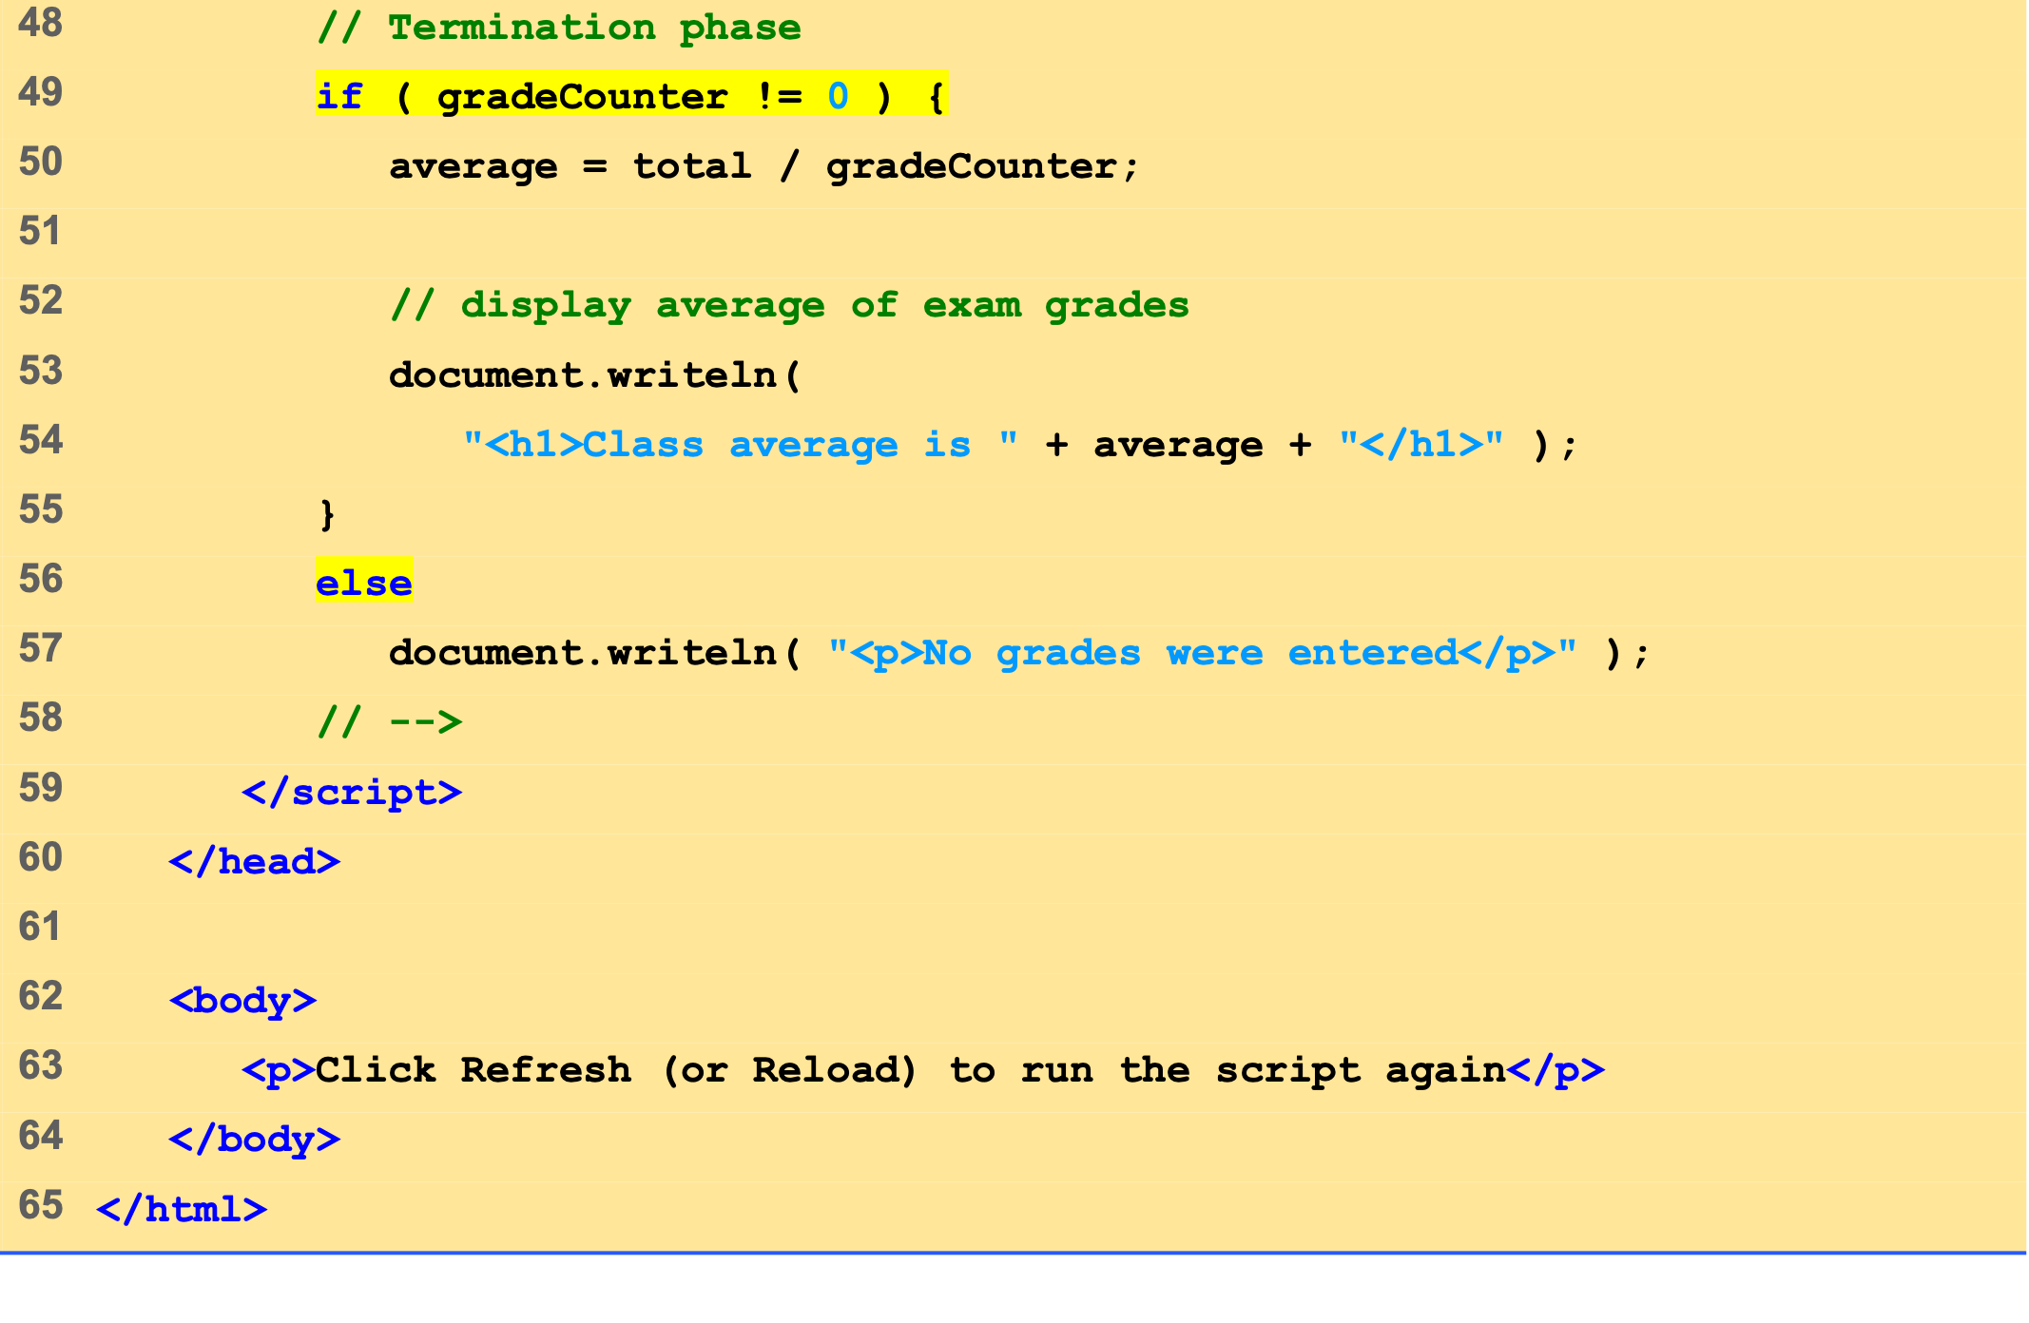
average2.html (3 of 3)

Slide 24
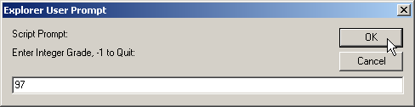
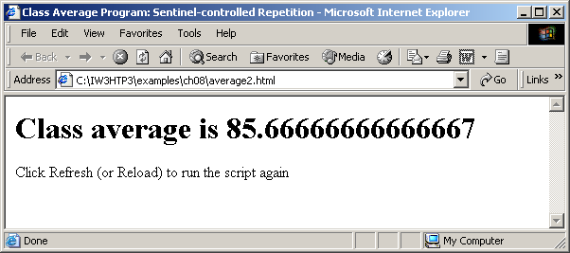

Slide 25
10 Formulating Algorithms with Top-Down, Stepwise Refinement: Case Study 3 (Nested Control Structures)
Consider problem
Make observations
Top-down, stepwise refinement

Slide 26
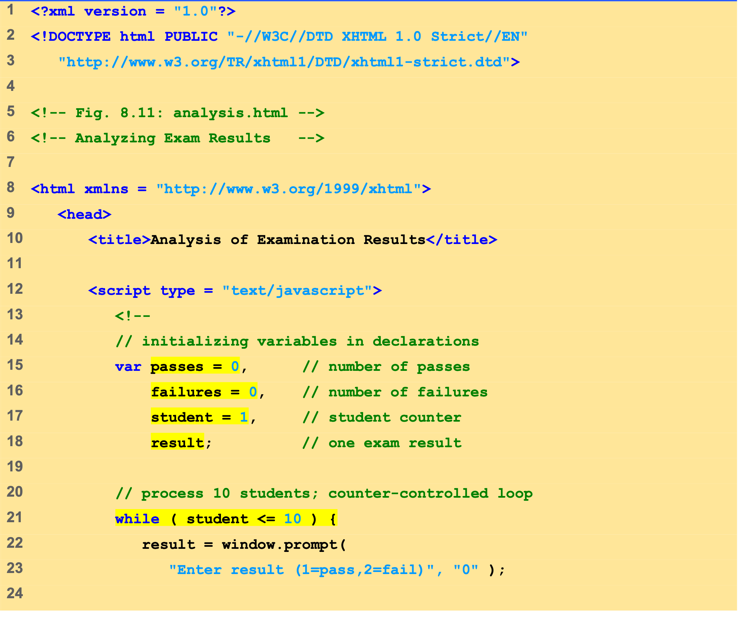
analysis.html (1 of 2)

Slide 27
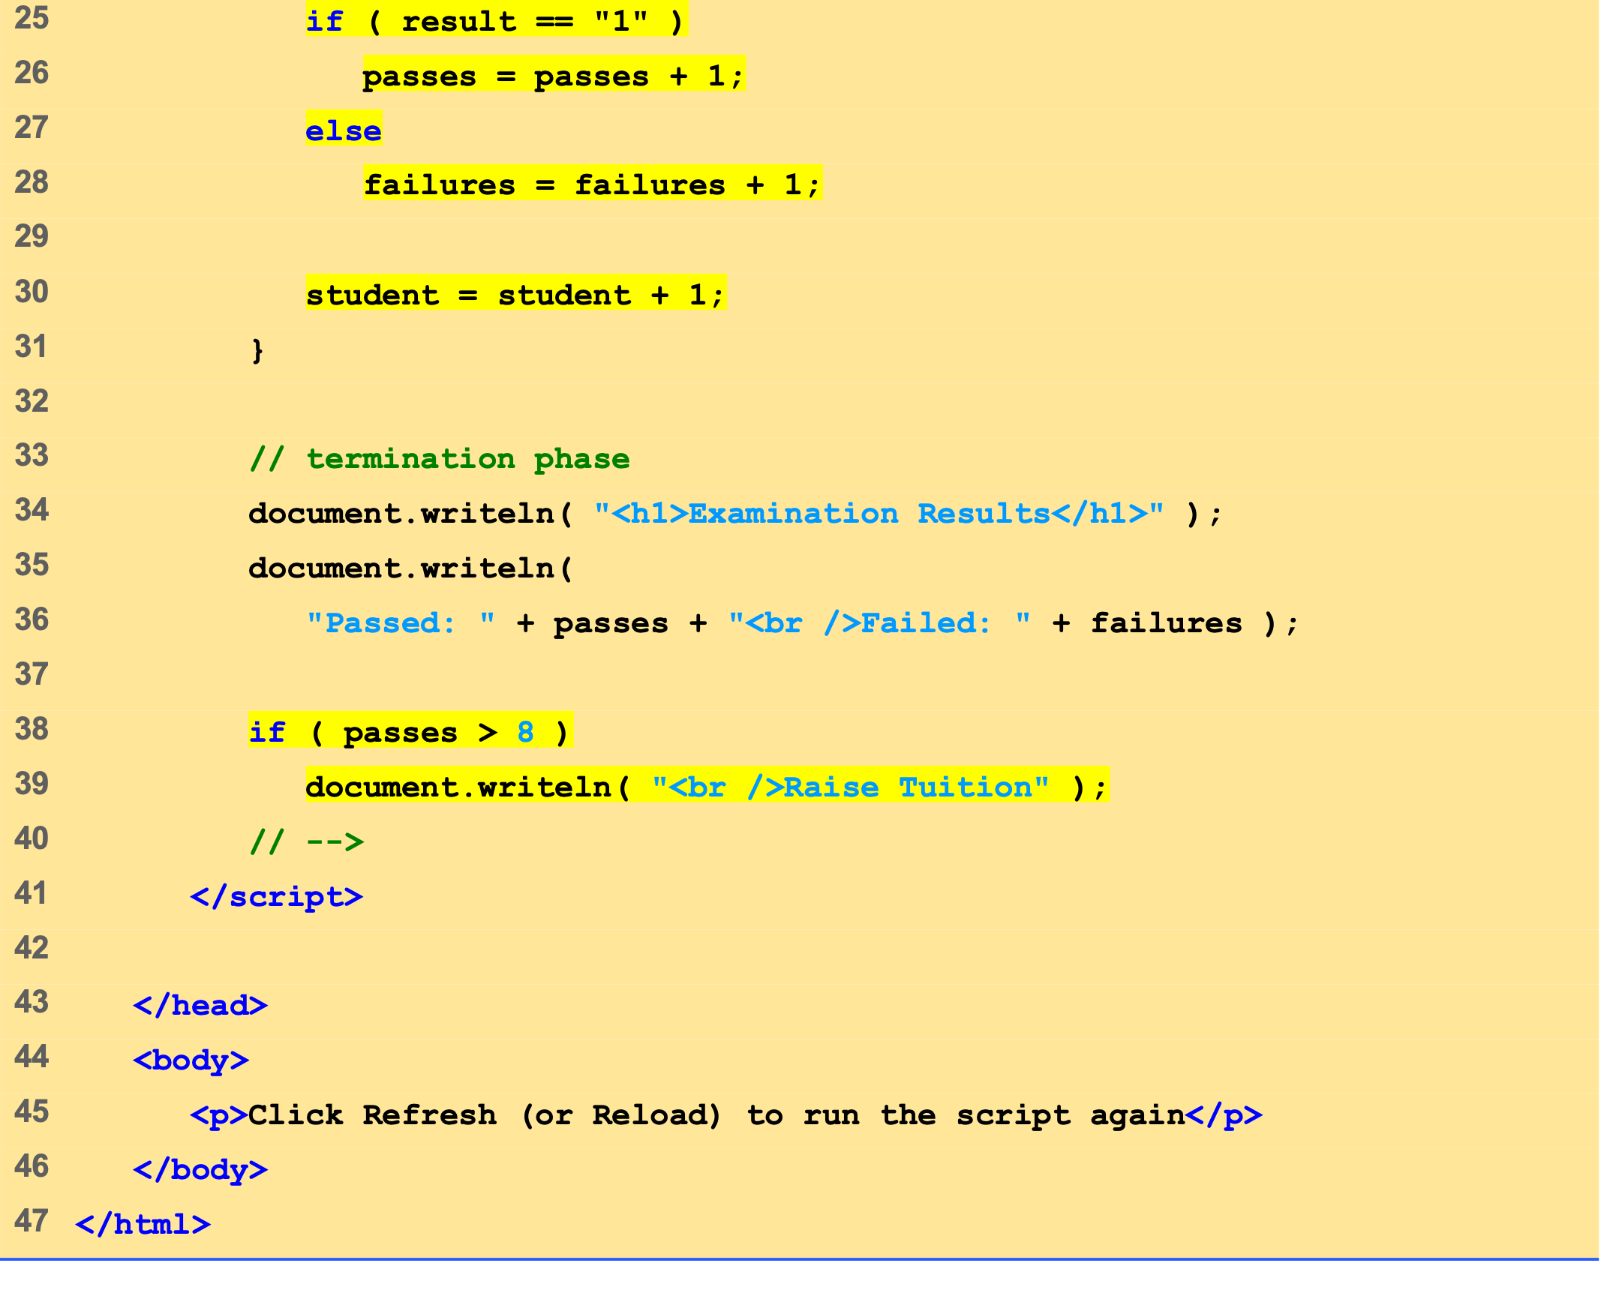
analysis.html (2 of 2)

Slide 28
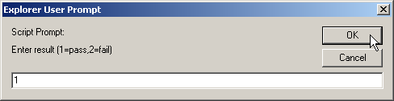
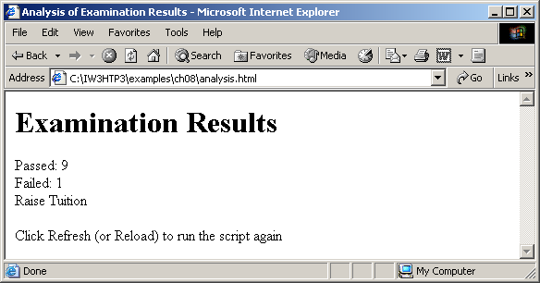

Slide 29
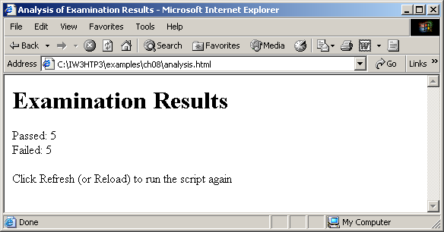

Slide 30
11 Assignment Operators
Compound assignment operators
Abbreviate assignment expressions

Slide 31
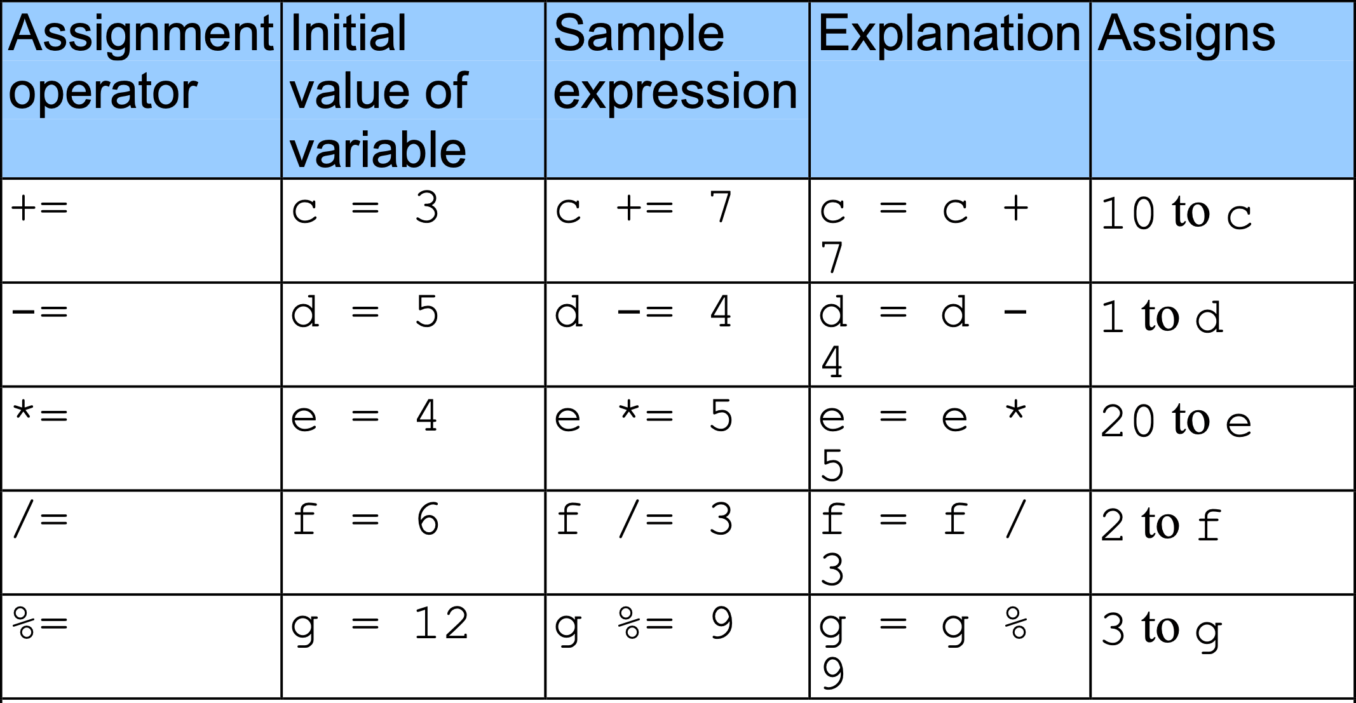
11 Assignment Operators

Slide 32
12 Increment and Decrement Operators
Preincrement or predecrement operator
Increment of decrement operator placed before a variable
Postincrement or postdecrement operator
Increment of decrement operator placed after a variable

Slide 33
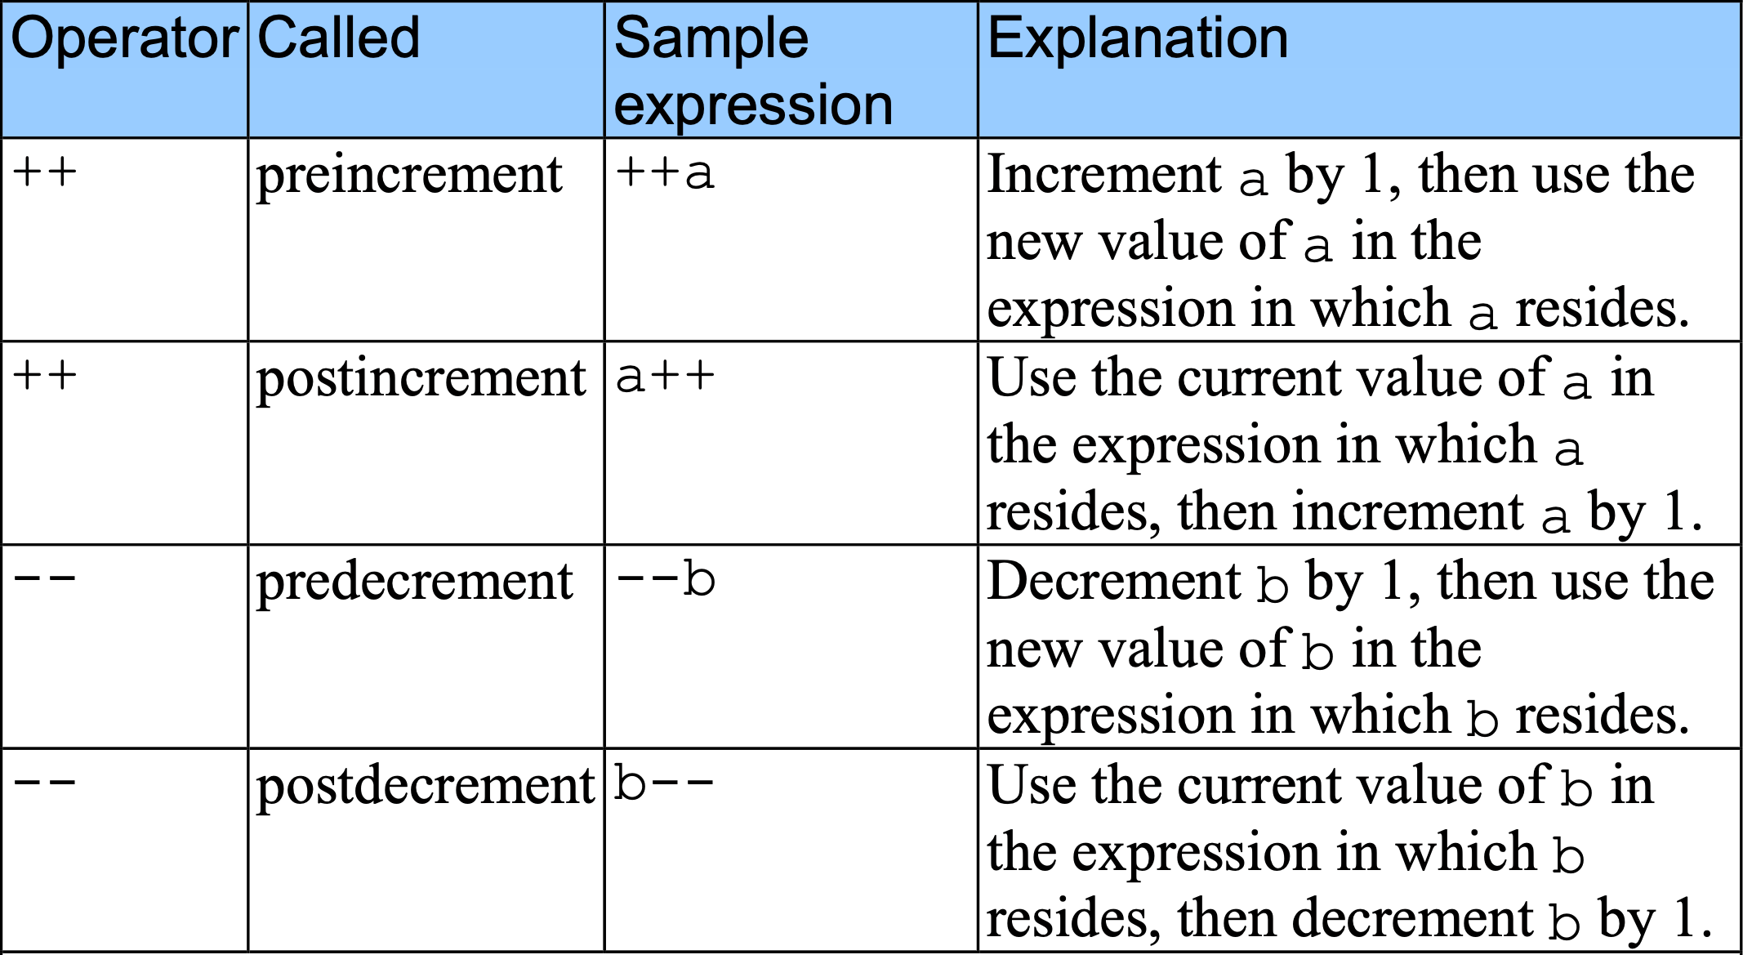
12 Increment and Decrement Operators

Slide 34
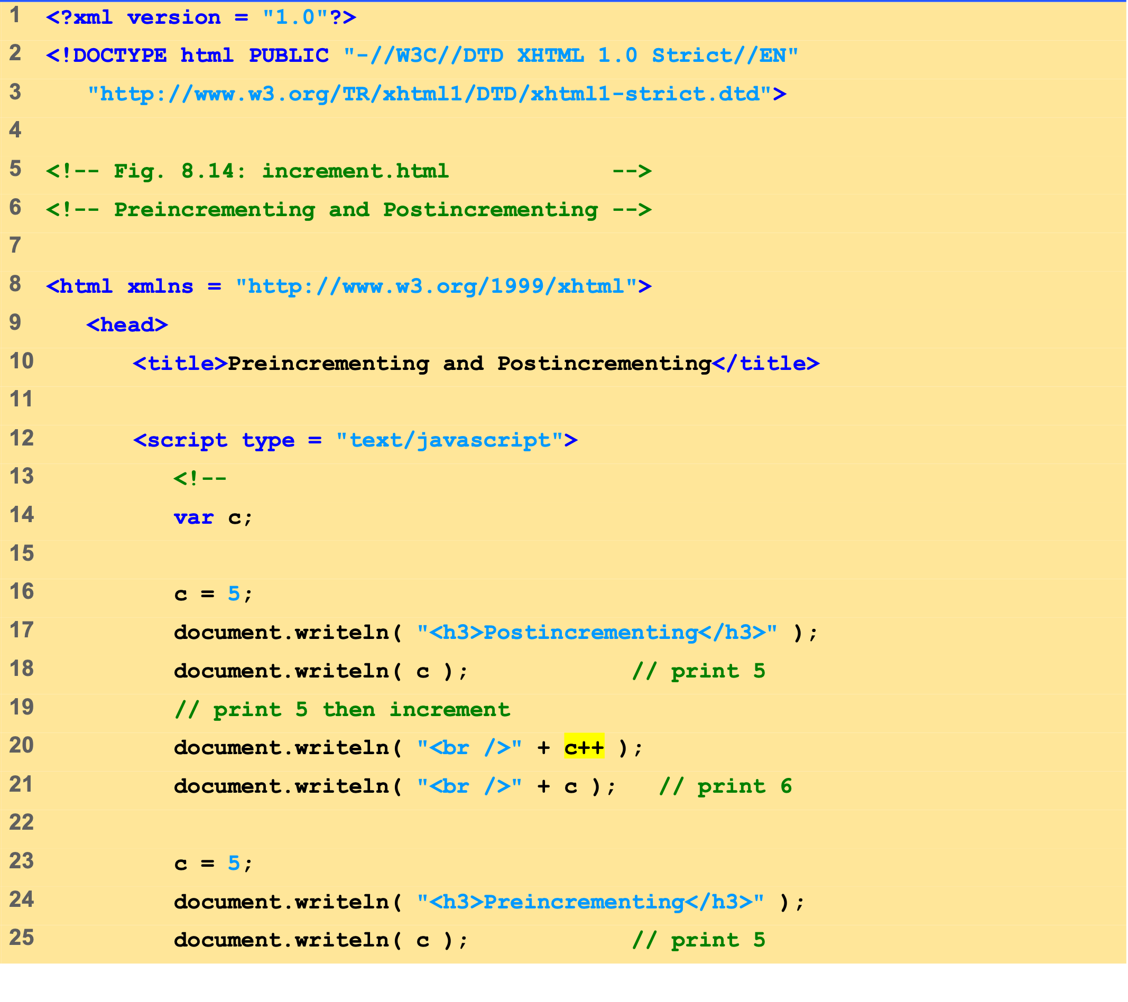
increment.html (1 of 2)

Slide 35
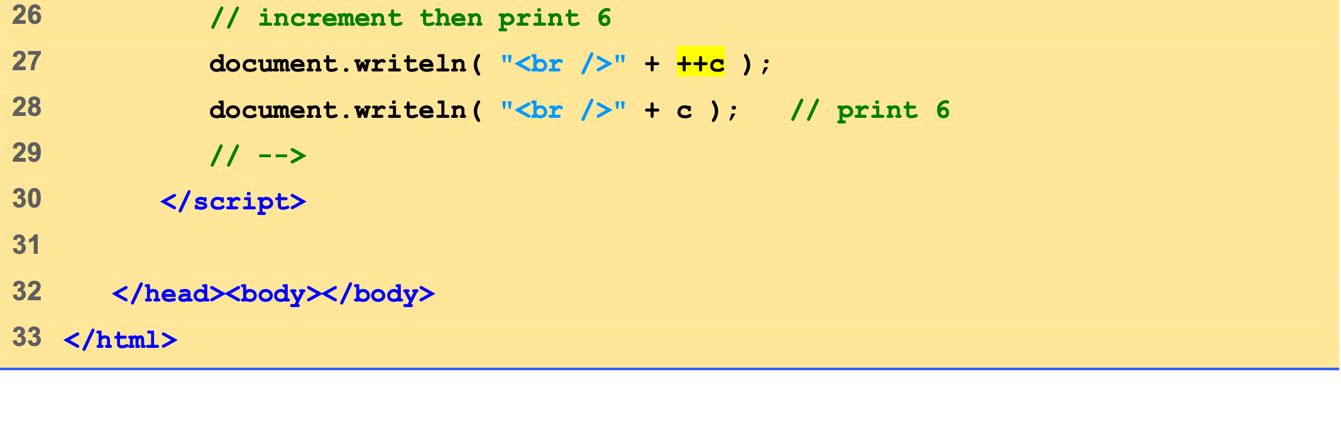
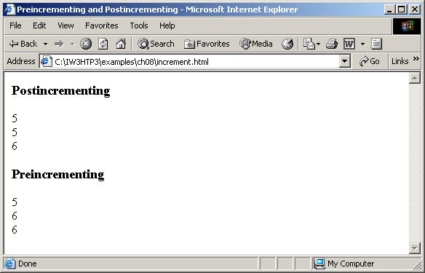
increment.html (2 of 2)

Slide 36
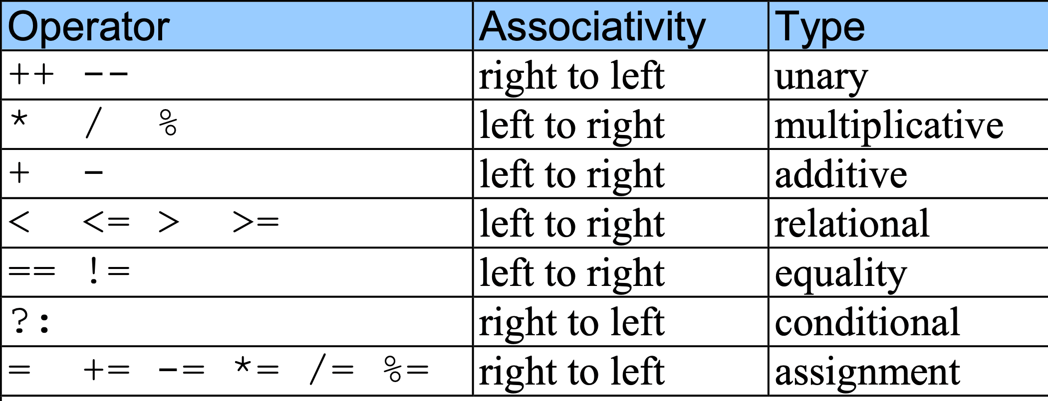
12 Increment and Decrement Operators

Slide 37
13 Note on Data Types
Loosely typed
Automatically converts between values of different types

Slide 38
14 Web Resources
www.javascriptmall.com
developer.netscape.com/tech/javascript
www.mozilla.org/js/language
Deitel and deitel, Internet and World Wide Web How to Program: Third Edition

